Slide 1

HR Analytics
Unlocking Insights from Employee Feedback Data

Slide 2
Index
Executive Summary
Q1-Exploratory Data Analysis – Demographics by Rating
Additional Insights
Q2-Correlation
Q3-Dissatisfaction Percentage
Q4-Sentiment Analysis
Q5-Top10 themes
Future - Advanced Analytics Using GenAI

Slide 3
Executive Summary
Objective: This HR data analysis aims to examine employee data and derive actionable insights, focusing on factors such as employee satisfaction related to location, gender, compensation and benefits, career growth, and work-life balance.
Value: The insights obtained will support data-driven decision-making to improve organizational efficiency, employee engagement, and overall workplace satisfaction.
Dataset Overview: The dataset comprises an Excel file with 25,866 rows and 10 columns, containing critical information to uncover meaningful trends and insights in the HR domain.
Analysis Results: Exploratory data analysis using advanced statistical techniques revealed significant patterns and relationships, offering valuable observations to guide HR strategies.

Slide 4
Problem 1
Conduct exploratory data analysis using the demographic variables and create relevant pivot views/charts with insights on rating scores

Slide 5
Exploratory Data Analysis – Location vs Overall Rating
To perform exploratory data analysis on location and get insights on its relationship with overall rating
Approach used: Statistical methods like Chi-Squared Test
Findings:
There is a very strong relationship between location and overall rating
LocA has highest “very dissatisfied” rate compared to other locations
Remote has got highest “very satisfied” rate compared to other locations

Slide 6
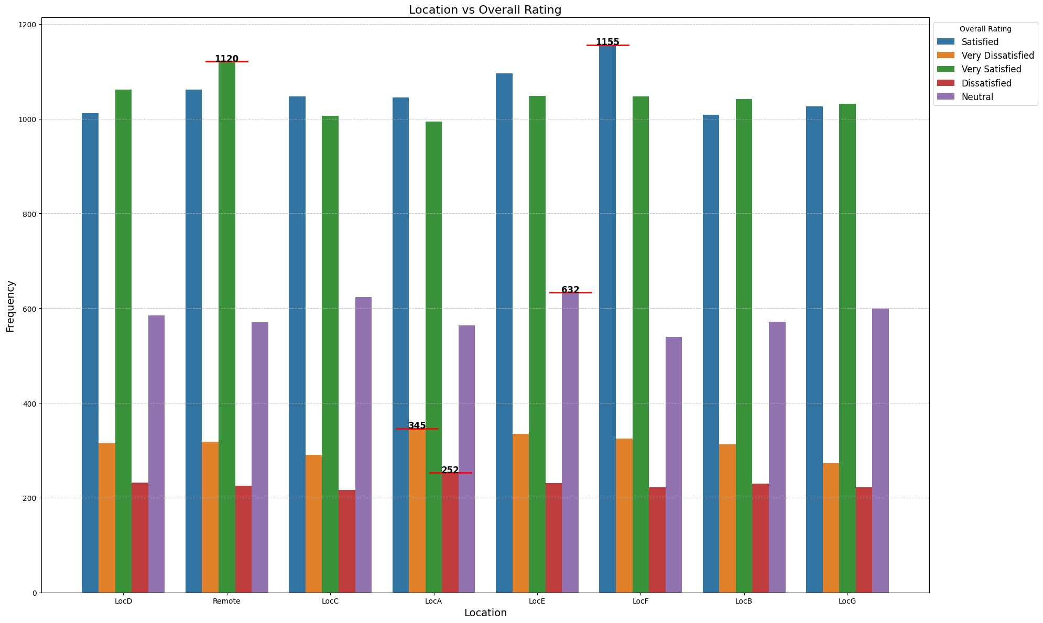
Location VS Overall Rating

Slide 7
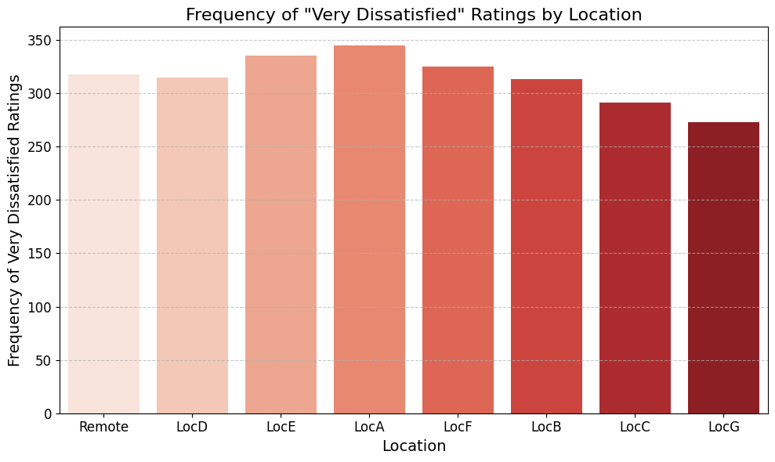
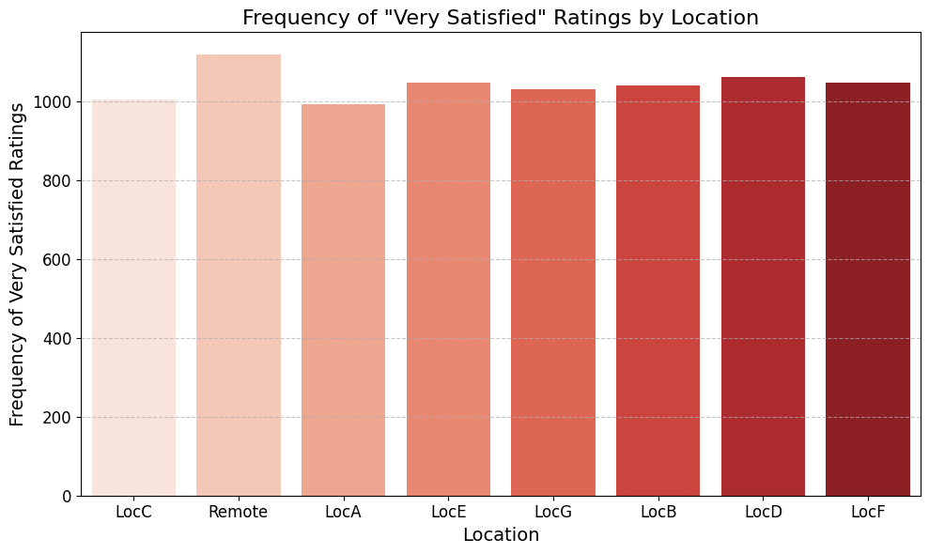

Slide 8
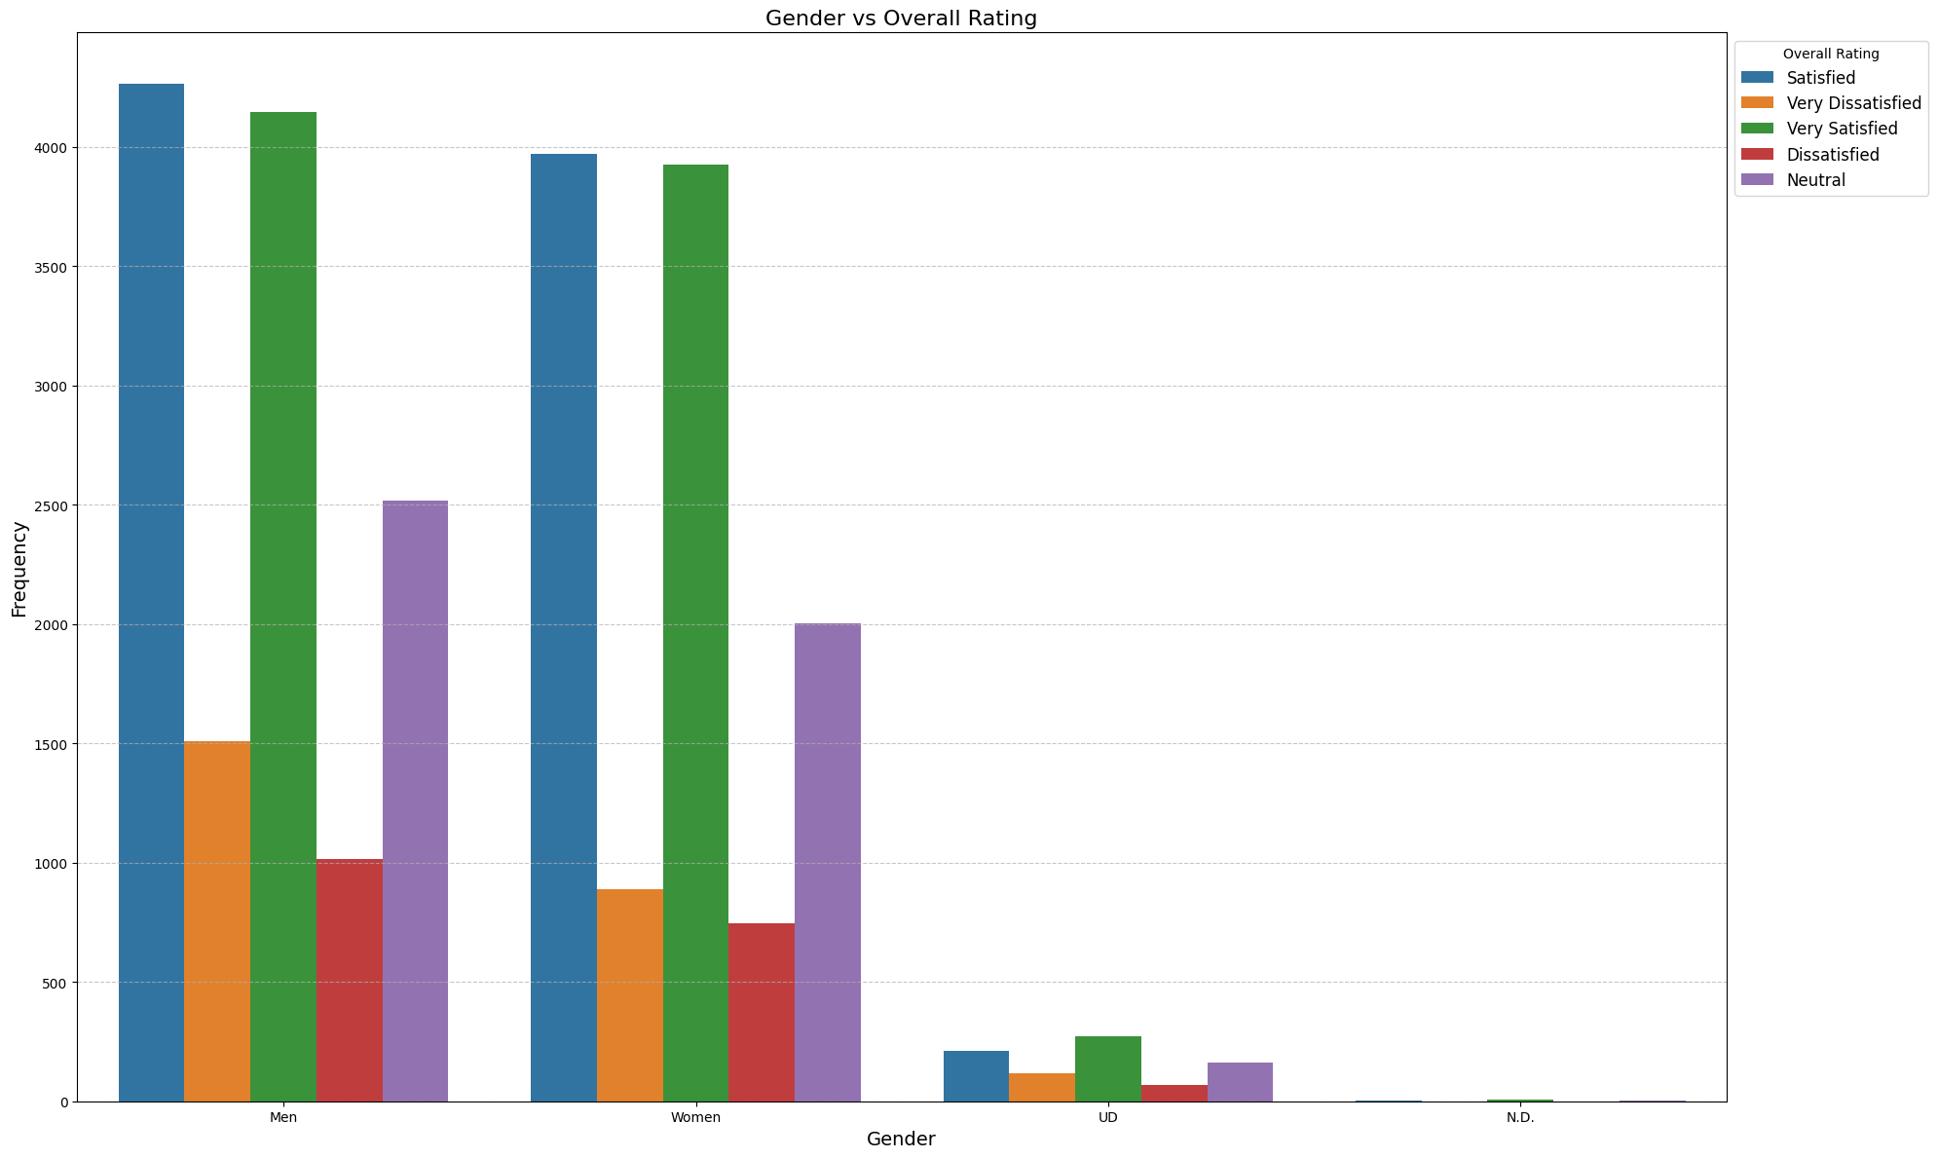
Exploratory Data Analysis – Gender Vs Overall Rating
To perform exploratory data analysis on gender and get insights on its relationship with overall rating
Approach used: Statistical method Chi-Squared Test
Findings:
There is a very strong relationship between Gender and overall rating
For all the categories in Overall Rating, maximum values are provided by Men

Slide 9
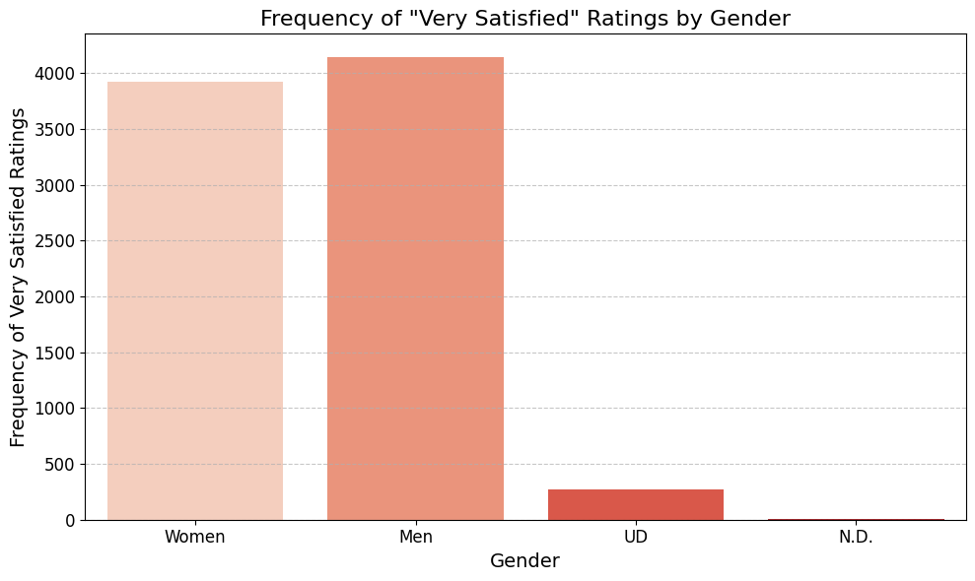
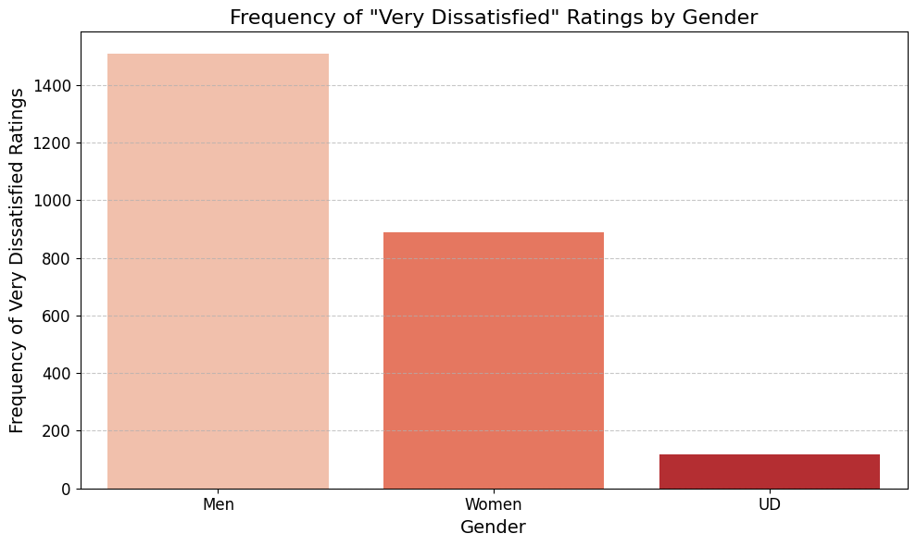

Slide 10
Women generally give slightly higher ratings than men at most locations
Remote has a consistently high rating (around 3.69) across genders, potentially suggesting a positive perception of remote work.
Gender | Men | N.D. | UD | Women
Location
LocA | 3.542 | 5.000 | 3.484 | 3.800
LocB | 3.653 | 3.333 | 3.593 | 3.778
LocC | 3.638 | NaN | 3.564 | 3.800
LocD | 3.605 | 3.666 | 3.618 | 3.835
LocE | 3.636 | 5.000 | 3.330 | 3.765
LocF | 3.642 | 4.250 | 3.698 | 3.815
LocG | 3.660 | NaN | 3.484 | 3.840
Remote | 3.693 | NaN | 3.572 | 3.810
Pivot Table :Overall Ratings by Location and Gender

Slide 11
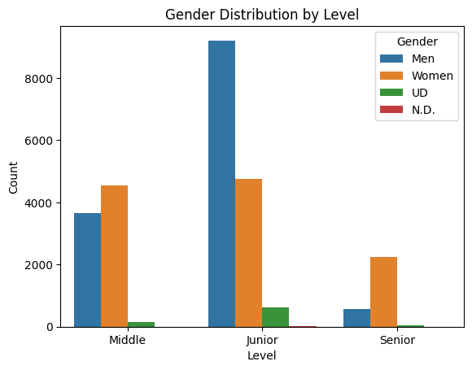
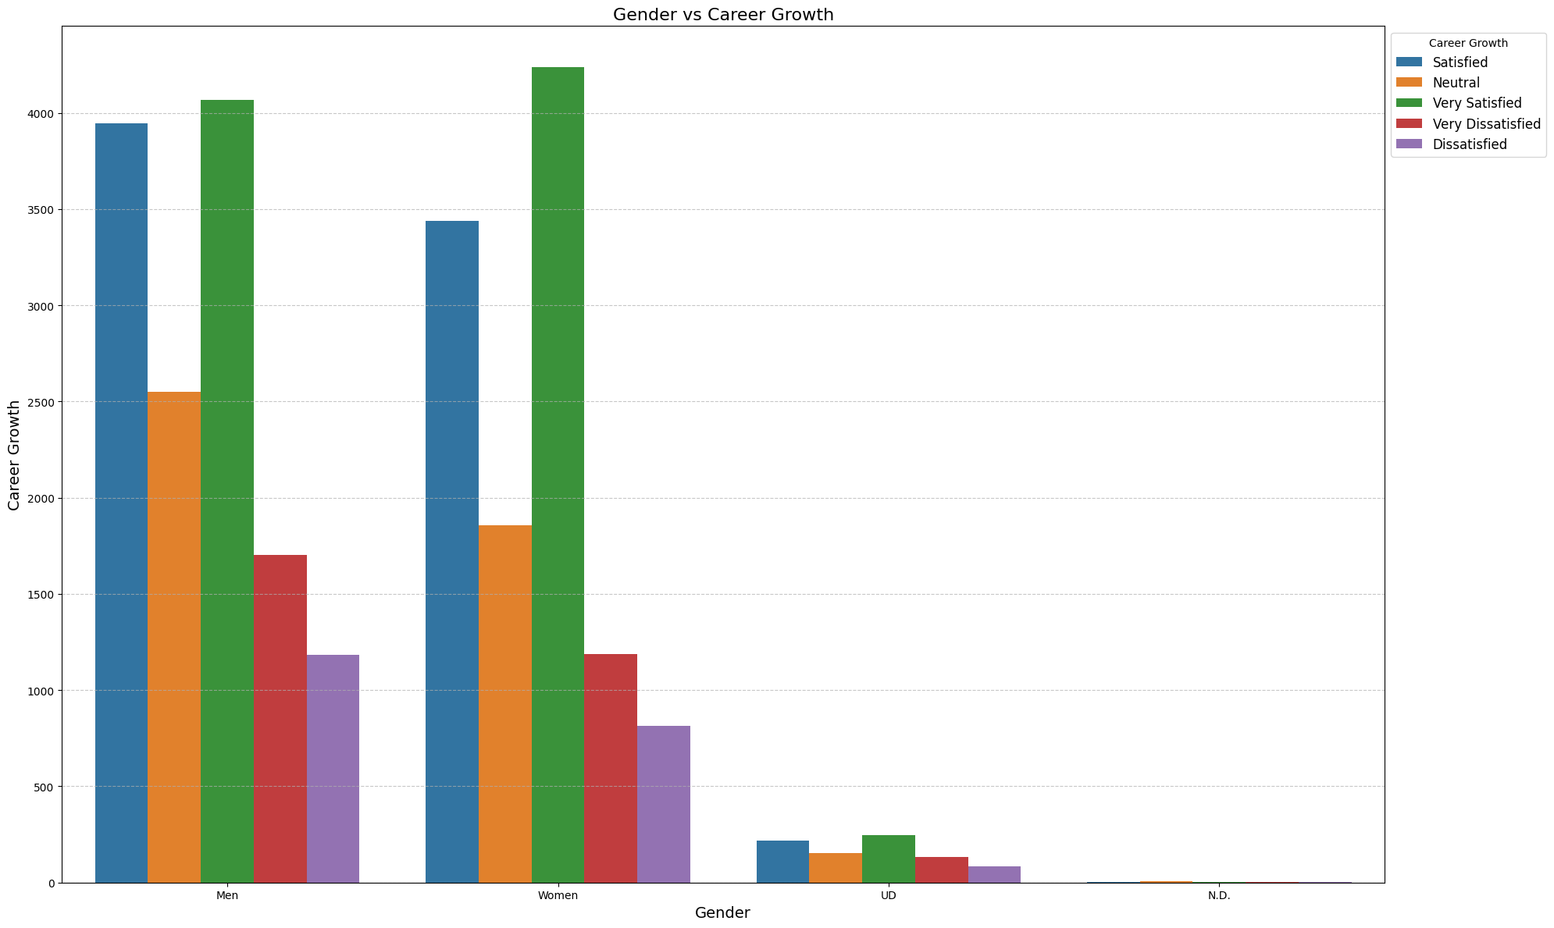
Additional Insights
Location has no statistical relationship with Compensation and Benefits, Career Growth and Work-life balance
There is a significant relationship between Gender and Career Growth
Male-Female ratio in career level is not following the same trend

Slide 12
Problem 2
Which among the 3 factors (in columns G, H & I) has the highest correlation with Overall Rating?

Slide 13
Correlation
To identify which feature among Career Growth, Compensation and Benefits, and Work-life Balance has got highest correlation with Overall Rating.
Technique used – Spearman correlation
Findings:
Overall Rating has highest correlation with Career Growth with a correlation value of 0.6869

Slide 14
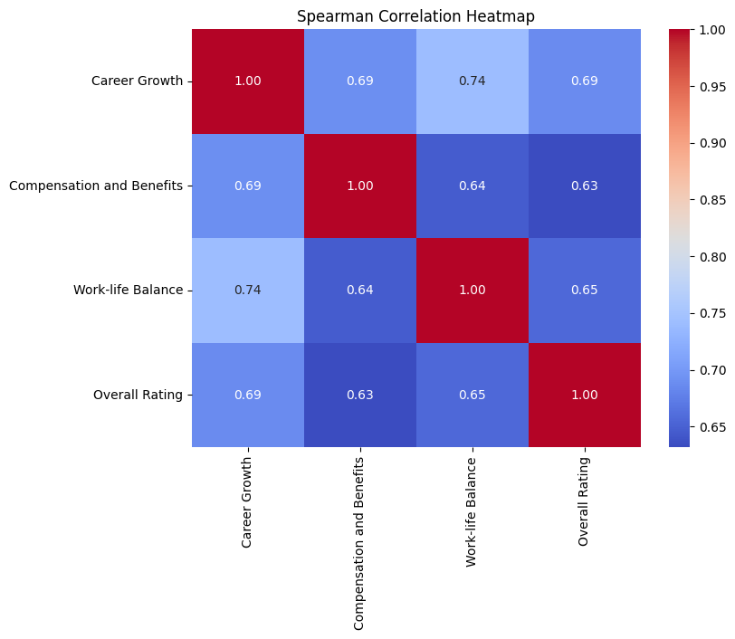
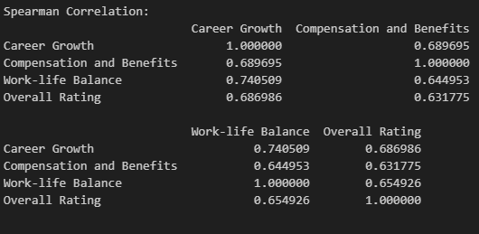

Slide 15
Problem 3
Are high tenured associates (15+ years) more dissatisfied compared to joiners since Covid period?

Slide 16
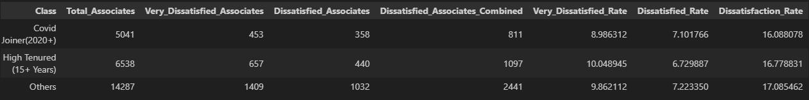
Dissatisfaction Percentage
To find if overall dissatisfaction percentage is more for High-tenured associates or Covid Joiners
Calculated the dissatisfied rate by considering “Dissatisfied” and “Very Dissatisfied” classes
Dissatisfaction rate – 16.77 for High Tenured Associates
Dissatisfaction rate – 16.08 for Covid Joiners
Findings:
High Tenured Associates (15+ years) has got highest dissatisfaction percentage compared to Covid Joiners

Slide 18
Problem 4
Analyze sentiment of Comments (col J) and share the findings

Slide 19
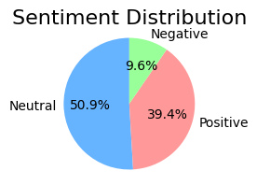
Sentiment Analysis
To identify the most recurring tone in the comments section provided by the employees
The technique used here is Sentiment Analysis combined with TextBlob for natural language processing (NLP)
Positive, Negative and Neutral are the categories considered
Neutral is the most repeating sentiment across the comments section followed by positive and then negative

Slide 20
Problem 5
Identify top 10 themes using the Comments, and represent the same using wordcloud

Slide 21
Top 10 themes and Wordcloud
To identify top 10 themes representing the comments column in the dataset and to visualize it using wordcloud
Removing default and custom stop words
Pre-processing by removing punctuations and converting to lowercase and use a counter on the words
Most recurring theme is “Work-life balance”

Slide 22
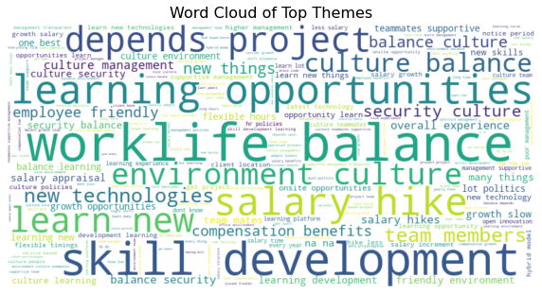
5 . Top 10 themes
Rank | Theme | Count
1 | Work-life balance | 262
2 | Skill development | 208
3 | Learning opportunities | 206
4 | Salary hike | 200
5 | Depends on the project | 156
6 | Learn new skills | 154
7 | Environment and culture | 120
8 | Culture balance | 119
9 | New technologies | 97
10 | Team members | 97

Slide 23
Future - Advanced Analytics Using Gen AI
Improved Feedback Analysis: Gen AI can analyze employee feedback more accurately, capturing nuanced sentiments and context beyond traditional NLP.
Uncover Hidden Insights: Gen AI can identify hidden patterns and emerging trends in feedback, providing deeper, actionable insights.
Automated Reporting: Gen AI can generate reports and highlight key trends, helping HR address issues proactively and improve engagement.

Slide 24


